Slide 1
Using Java 8’s Optional
Author: Minh Nguyen

Slide 2
Issue of Null Pointer Exception
An example to see the dangers of null
We want to get street name of company of Person by following way:
String streetName = person.getCompany().getAddress().getStreetName();
=> Person does not join in any Company, what happened?
Person
Company
Address

Slide 3
Solution
Add checks to prevent null dereferences
String streetName = “UNKOWN”;
If (staff != null) {
Company company = staff.getCompany();
If (company != null) {
Address address = company.getAddress();
if (address != null) {
streetName = address.getStreetName();
}
}
}
return streetName;
Disadvantage: We need a lot of boilerplate code to make sure we don't get a NullPointerException

Slide 4
How other languages solve this problem
Groovy have a safe navigation operator (http://www.groovy-lang.org/operators.html#_safe_navigation_operator):
String streetName = staff?.getCompany()?.getAddress()?.getStreetName();
Haskell includes a Maybe type, which essentially encapsulates an optional value. A value of type Maybe can contain either a value of a given type or nothing.
Scala has a similar construct called Option[T] to encapsulate the presence or absence of a value of type T

Slide 5
Optional in a Nutshell
Java SE 8 introduces a new class called java.util.Optional<T> that is inspired from the ideas of Haskell and Scala. It is a class that encapsulates an optional value.
Optional<Person>
Optional<Person>
Person
Contains object of type Person
An empty Optional

Slide 6
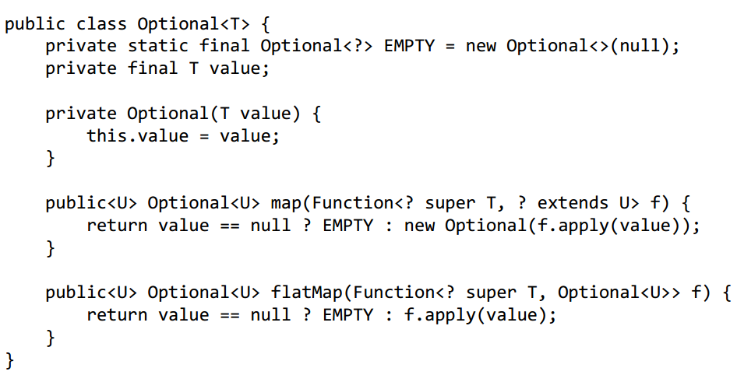
Optional in Java 8

Slide 7
How to use Optional
public class Person { private Optional<Company> company; public Person(Company company) { this.company = Optional.ofNullable(company); } public Optional<Company> getCompany() { return this.company; } }
public class Company { private Optional<Address> address; public Company(Address address) { this.address = Optional.ofNullable(address); } public Optional<Address> getAddress() { return this.address; } }

Slide 8
How to use Optional
Person person = new Person(null); Optional<Person> personOptional = Optional.of(person); String streetName = personOptional.flatMap(Person::getCompany) .flatMap(Company::getAddress) .map(Address::getStreetName) .orElse("Unknown"); System.out.println(streetName);
➔ Result: Unknown

Slide 9
Drawbacks of Optional
Increases heap size
Optional is a wrapper which means if you use it you'll now have two object references where you used to have one.
Makes debugging more difficult
Makes serializing objects, say as an XML or JSON for an external client, much more difficult

Slide 10
Reference links:
http://www.oracle.com/technetwork/articles/java/java8-optional-2175753.html
http://www.slideshare.net/mariofusco/monadic-java
https://dzone.com/articles/use-of-optional-is-optional
Book: Java 8 in Action: Lambdas, Streams, and Functional-style Programming

